Slide 1
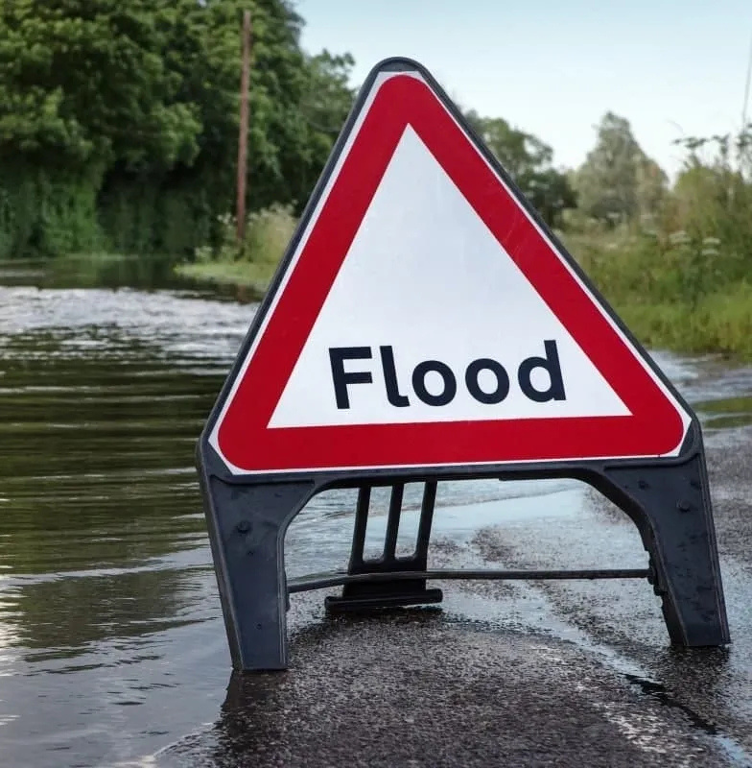
EN3251 Internet of Things
IoT-Based Flood Monitoring and Early Warning System
Team Members:
1) De Zoysa A.K.N - 210108C
2) Dimagi D.H.P. - 210131N
3) Dissanayaka D.M.P.C. - 210140P

Slide 2


Introduction
Problem Statement: Floods cause extensive damage to lives, infrastructure, and the environment. Monitoring and early detection are essential for mitigating risks.
Objective: To develop a real-time flood monitoring system with early warning capabilities.
Key Features:
Automated data collection from sensors.
Real-time alerts via SMS notifications.
Cloud-based data storage and visualization

Slide 3
System Overview
This system integrates IoT devices like ultrasonic sensors and DHT22 to monitor environmental parameters and notify users in case of potential flood risks.
It leverages MQTT protocol, ThingSpeak cloud, and Node-RED for data handling, visualization, and notifications.

Slide 4
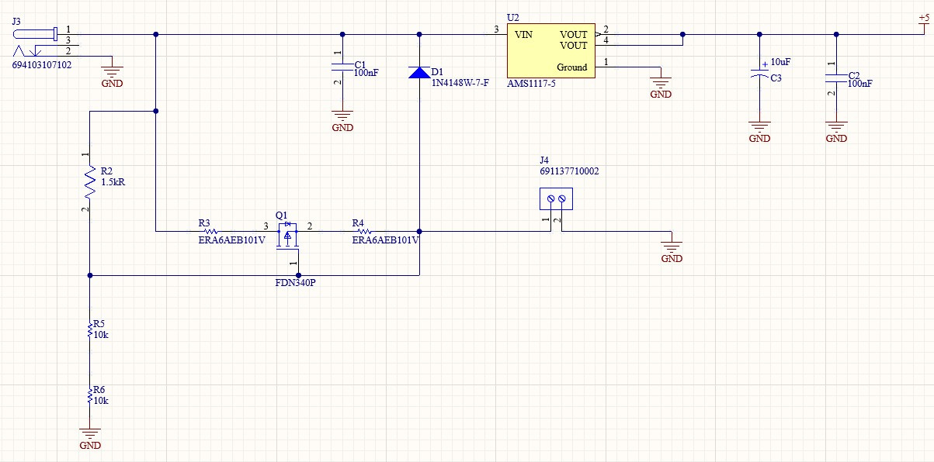
PCB Schematic

Slide 5
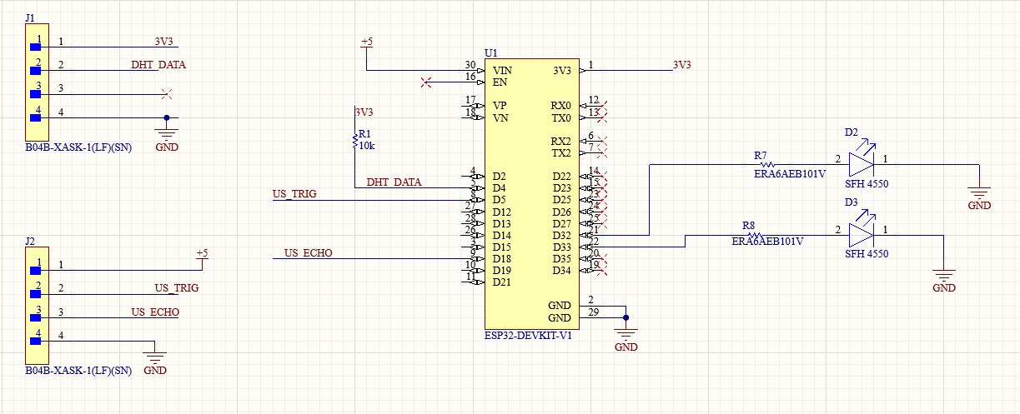
PCB Schematic

Slide 6
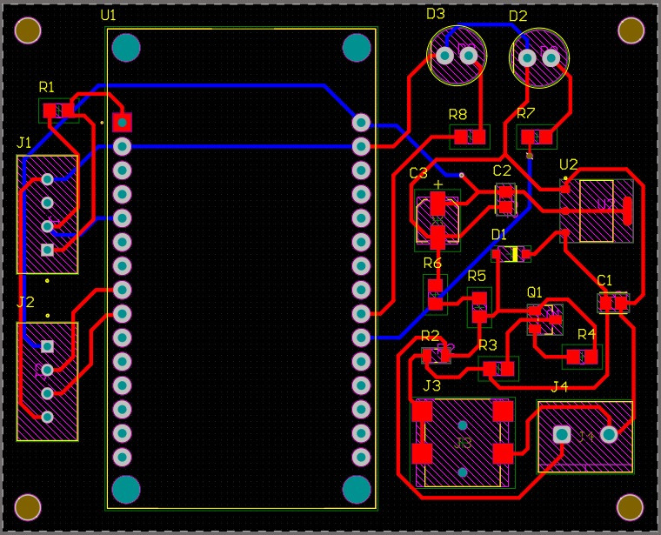
PCB Layout

Slide 7
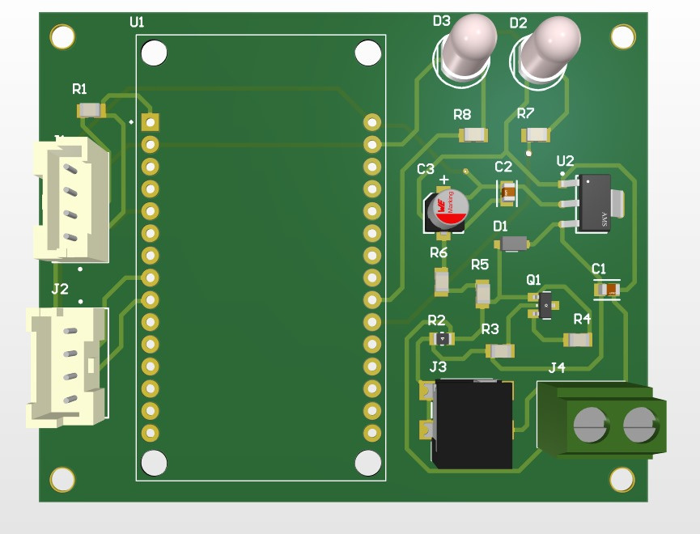
3D View

Slide 8
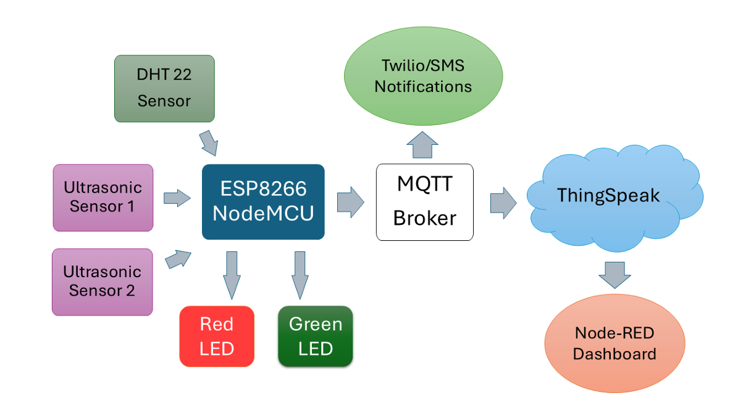

System Architecture

Slide 9
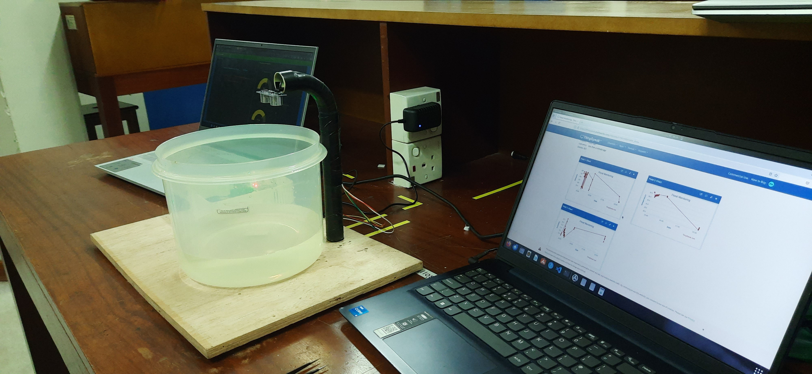
End-Devices
Ultrasonic Sensors: Measure water levels and detect potential flooding by calculating distances based on sound waves.
DHT22 Sensor: Monitors temperature and humidity to assess weather conditions.
ESP32 (NodeMCU): Serves as the central controller, transmitting sensor data to the cloud via MQTT.
Rechargeable Battery: Ensures uninterrupted operation during power outages.

Slide 10
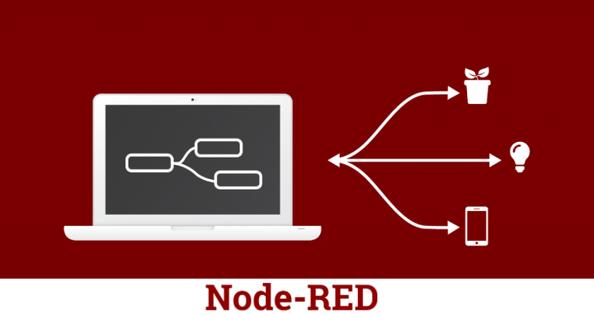


Management Interface
Node-RED Dashboard: A web-based platform displaying real-time data, accessible via computers or smartphones.
ThingSpeak Cloud: Stores and processes sensor data, triggering alerts when thresholds are met.
Twilio SMS Notifications: Sends real-time alerts to users when water levels are critical.

Slide 11
Functional Workflow
Data Collection: Sensors gather water levels, temperature, and humidity data.
Data Transmission: ESP32 sends data to the ThingSpeak cloud via MQTT.
Data Processing: Node-RED processes and visualizes data; sends SMS alerts if thresholds are breached.
Power Management: Switches to battery power during outages.

Slide 12

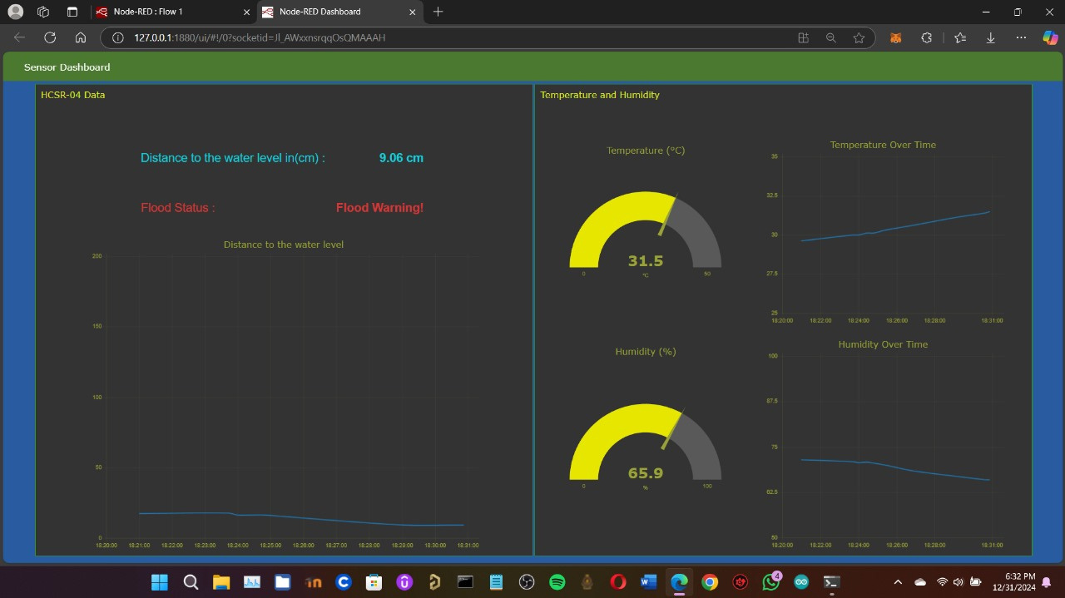
Node-RED Dashboard

Slide 13
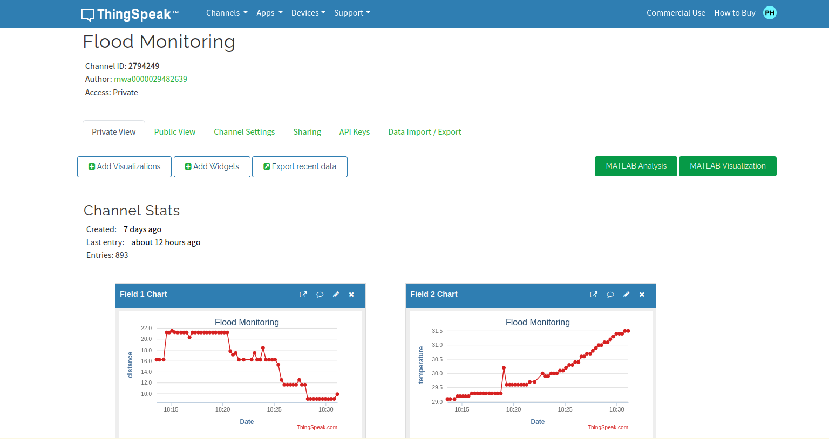
ThingSpeak Integration

Slide 14
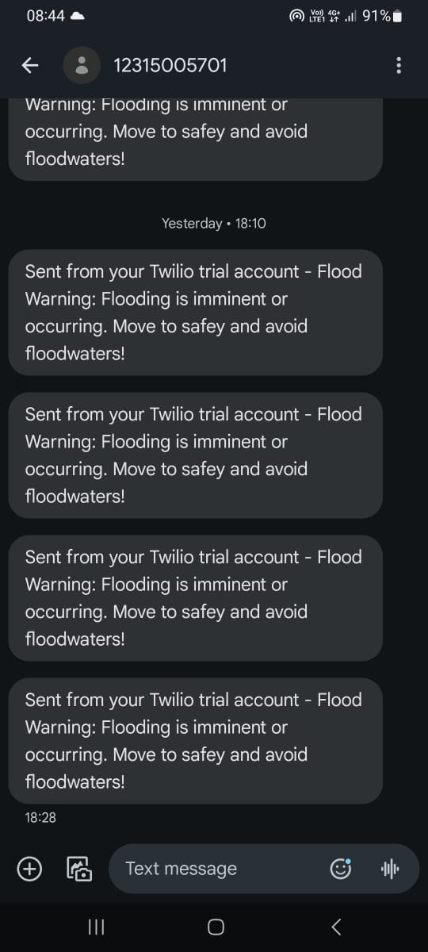
Twilio

Slide 15
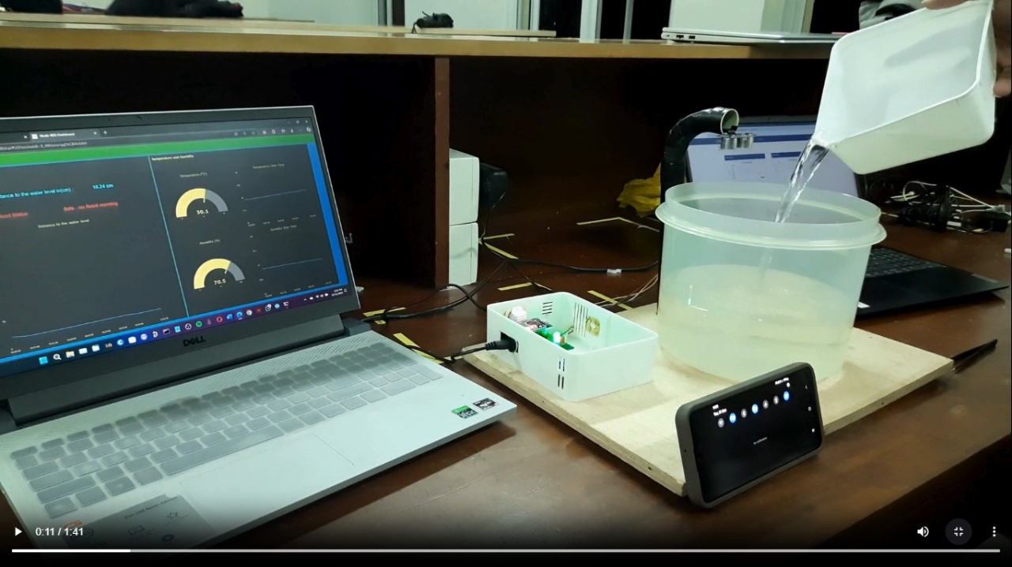
Working Prototype

Slide 16

Thank You

